Slide 1
ONLINE RESUME BUILDER WEB APPLICATION
LRG GOVERNMENT ARTS COLLEGE FOR WOMEN POOVIZHI T
III – B.SC COMPUTER SCIENCE,SHIFT - I
GUIDE NAME : Mrs.SASIREKHA MSc..Mphil..

Slide 2
AGENDA
ABSTRACT
OBJECTIVE
SYSTEM SPECIFICATION
EXISTING SYSTEM
PROPOSED SYSTEM
MODULES
DATA FLOW DIAGRAM
FORM DESIGN
TABLES

Slide 3
ABSTRACT
An online resume builder is a software developed to simplify the task of creating a resume for individuals.
The application provides an effective means of designing desired resume in fact a professional looking resume.
The system is flexible to be used and reduces the need of thinking and designing an appropriate resume according to qualifications.
Usually individuals get confused while creating a resume especially for a novice person such as graduate students.
They don’t get a clear idea of what things and information must be included in a resume. Hence the system is developed to provide them an easy way for creating a professional looking resume .

Slide 4
OBJECTIVES
This project is user-friendly and requires minimum human intervention.
Individuals just have to fill up a form that specifies questions from all required fields such as personal questions, educational, qualities, interest, skills and so on.
The answers provided by the users are stored and the system automatically generates a well-structured resume.
Users have option to create resume in any format and file.

Slide 5
SYSTEM SPECIFICATION
HARDWARE SPECIFICATION:
Processor : P 4 700 GHz.
RAM : 4 GB RAM
Hard Disk Drive : 180 GB
SOFTWARE SPECIFICATION:
Operating System : Windows 7/8/10
Front End : JAVA
Back End : MYSQL

Slide 6
EXISTING SYSTEM
The existing system of the resume builder is prepared in the MS-Word Application software.
The Format which is designed is manual. But creating different resume formats is not easy.
To reduce the burden we have developed this software

Slide 7
DISADVANTAGES
There is no database to store and retrieve the details from MS-Word
Time delay is more because we have to prepare the resume manually

Slide 8
PROPOSED SYSTEM
The proposed system tries to solve the problems mentioned above.
The main objective of the proposed system is to provide information instantly as and when it is required.
The main objective is to make the DEVELOPMENT OF A FUTURE PROFESSIONAL RESUME BUILDER APPLICATION details more efficient.
This system should maintain different data files and resume formats, so that the data can be retrieved easily and in an efficient manner.
The system is very interactive. It should ensure process integration to the desired extent, various reports should be generated as the need be.
This system should also ensure that there is no redundancy in the recorded data.

Slide 9
ADVANTAGES
To store all details of the persons personal, educational and skill details, so that it provide better services to users.
The proposed system provides efficient management resumes.
Because of computerization manual work is eliminated and manual errors can be overcome easily.

Slide 10
MODULES
User Registration
Resume Template
Resume Form
Resume Builder
Download Resume

Slide 11
User login:
Users have to create an account into the system by registering themselves. Then they may login into the system and can utilize services.
Resume templates:
The system contains various kinds of resume templates for all kind of qualification i.e. for both fresher and experienced. And also, according to the kind of degree one has.
Resume form:
Users on selecting the format will be given an online form to be filled. The form includes questions like academics, personal, interests, hobbies, skills, courses, experience and so on.

Slide 12
Resume builder:
On submitting the form the system stores the data and within a short period of time generates resume in selected format.
Download Resume:
Download the created as resume as per expected design format. Can download the resume as any format to this application.

Slide 13

DFD Level 0:

Slide 14
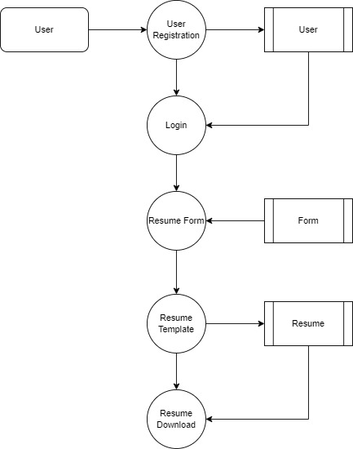
Level 1:

Slide 15
TABLE DESIGN TABLE NAME:USER
FIELD | DATA TYPE | SIZE | CONSTRAINT
User id | Int | 10 | Primary key
Username | Varchar | 30 | Not null
password | Varchar | 30 | Not null
First Name | Varchar | 30 | Not null
Last Name | Varchar | 30 | Not null
Mobile | Varchar | 10 | Not null

Slide 16
TABLE NAME:FORM
FIELD | DATA TYPE | SIZE | CONSTRAINT
Form id | Int | 10 | Primary key
Builder Name | Varchar | 30 | Not null
Qualification Details | Varchar | 30 | Not null
Expierence | Varchar | 30 | Not null
Education Details | Varchar | 30 | Not null
Sklls | Varchar | 100 | Not null

Slide 17
TABLE NAME:RESUME
FIELD | DATA TYPE | SIZE | CONSTRAINT
Resume id | Int | 10 | Primary key
Download Url | Varchar | 30 | Not null
Resume size | Varchar | 10 | Not null
Resume Name | Varchar | 30 | Not null

Slide 18
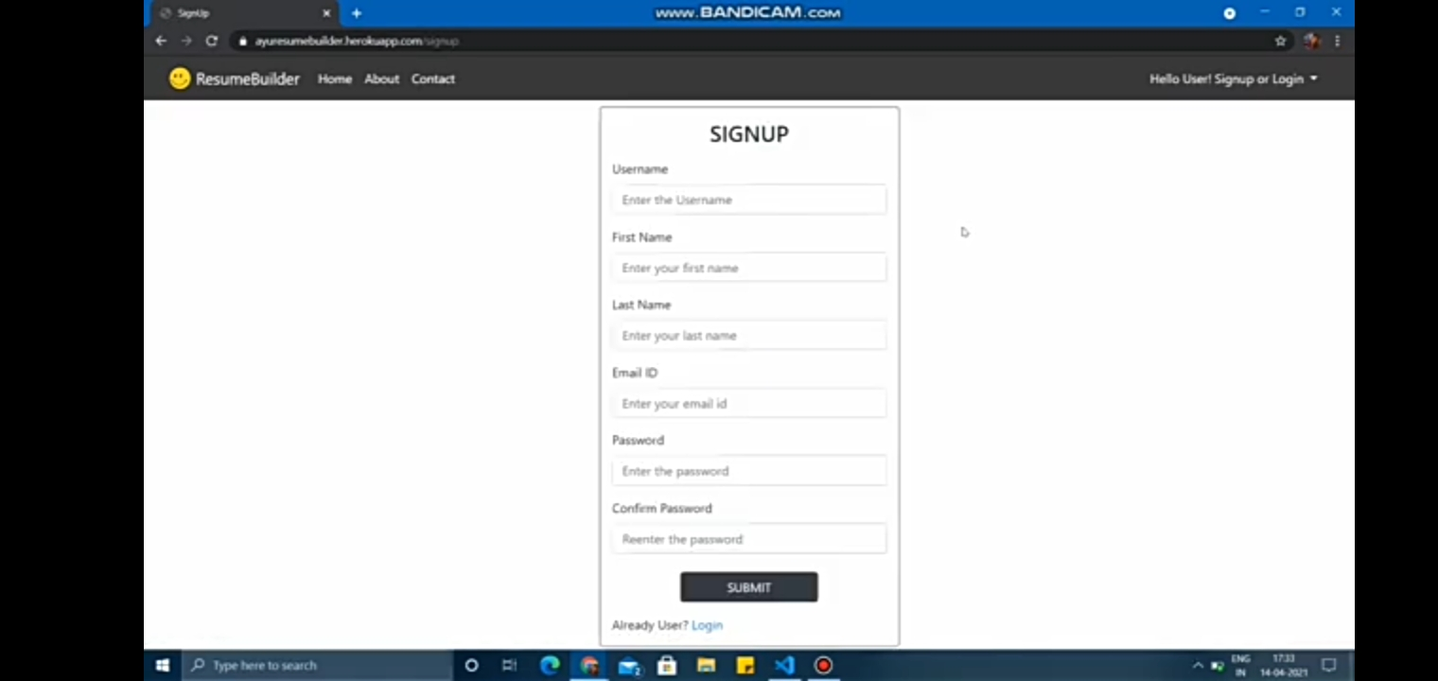
FORM DESIGN

Slide 19
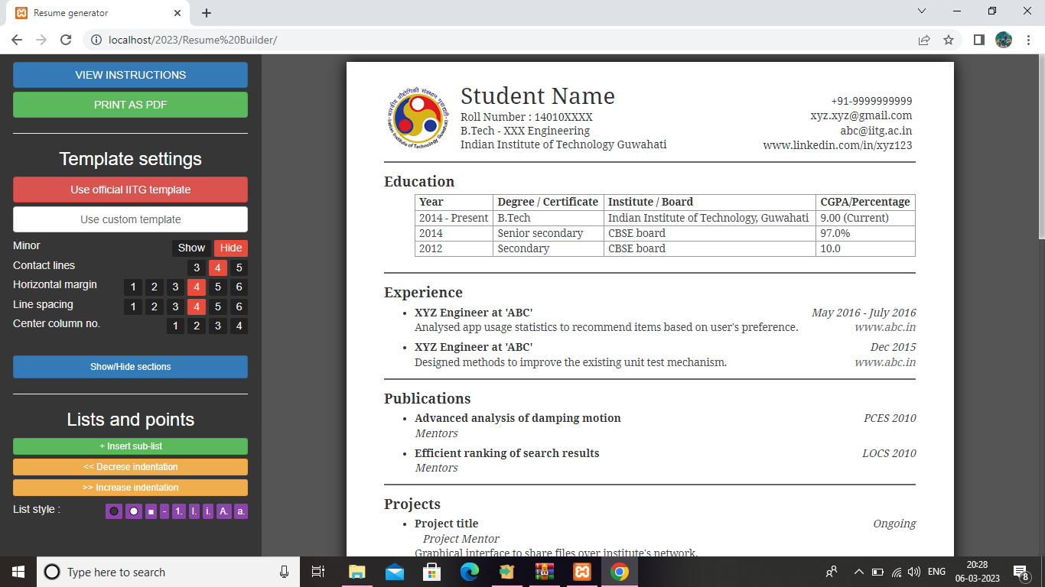

Slide 20
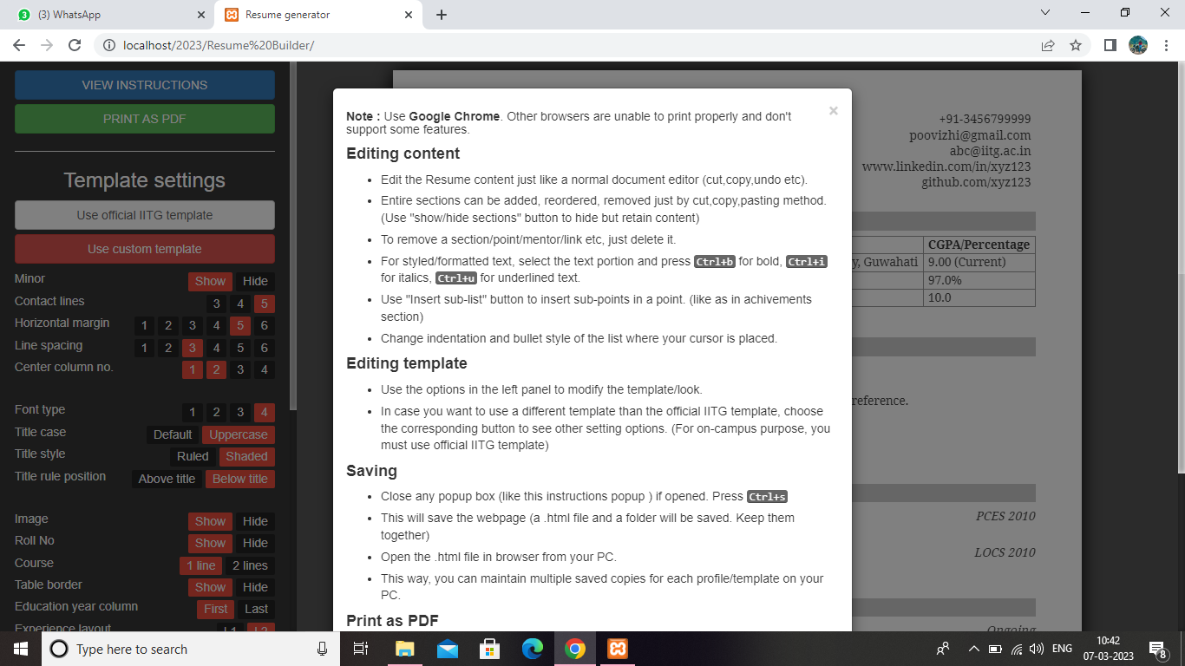

Slide 21
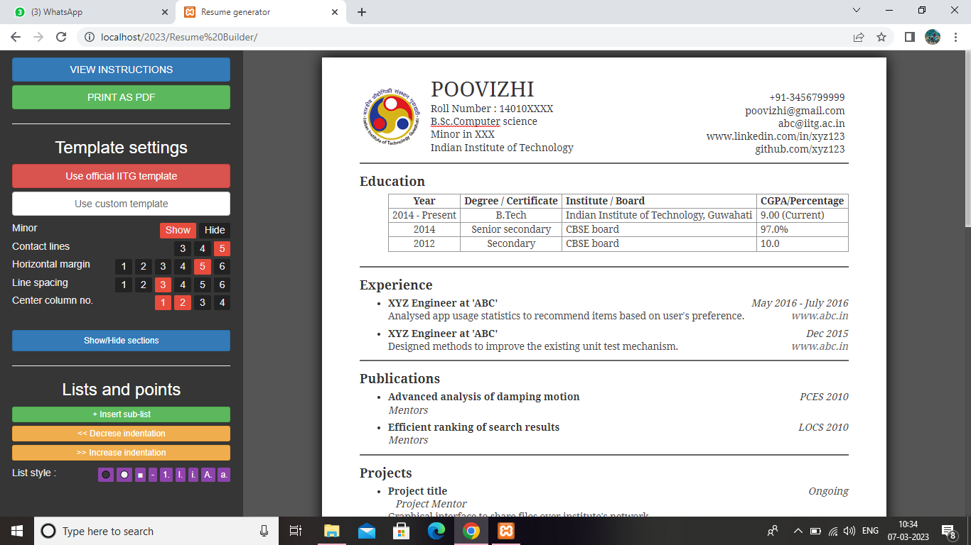

Slide 22
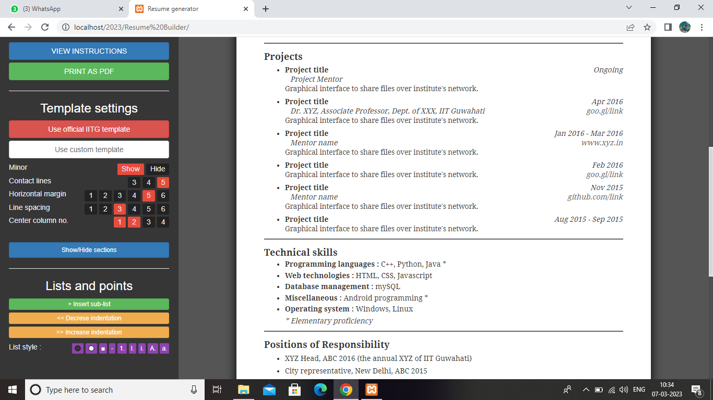

Slide 23
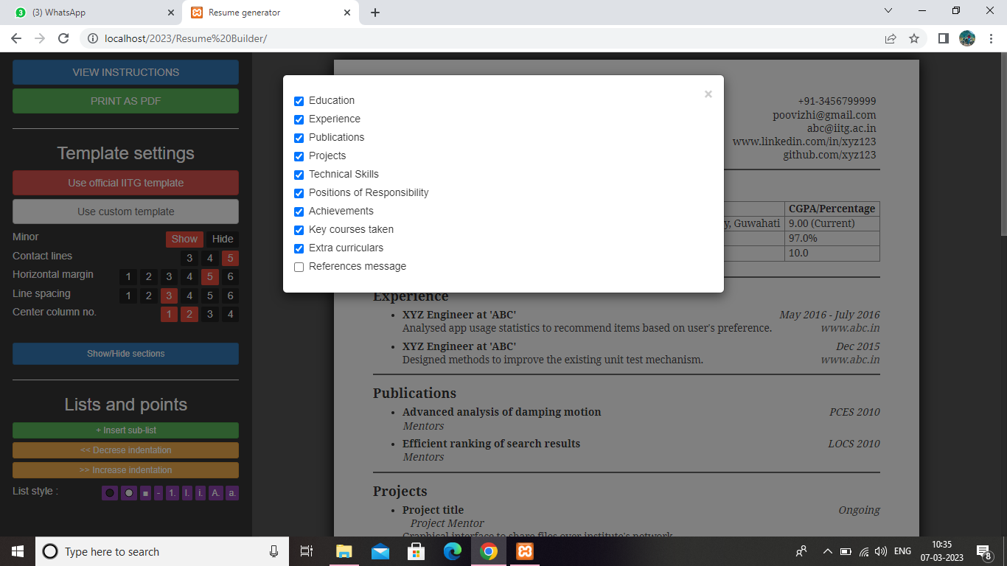

Slide 24
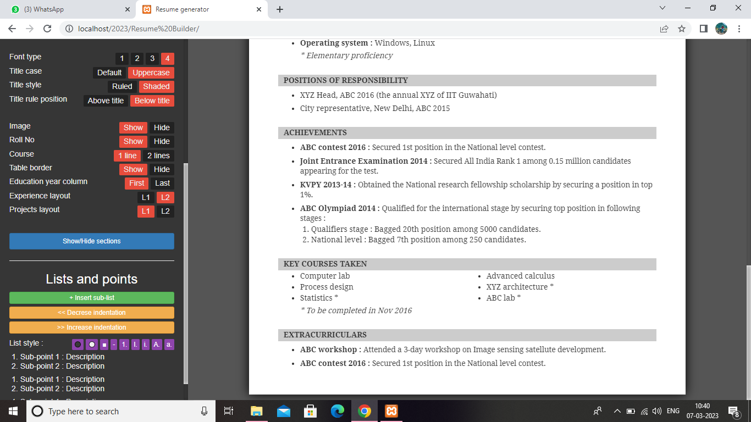

Slide 25
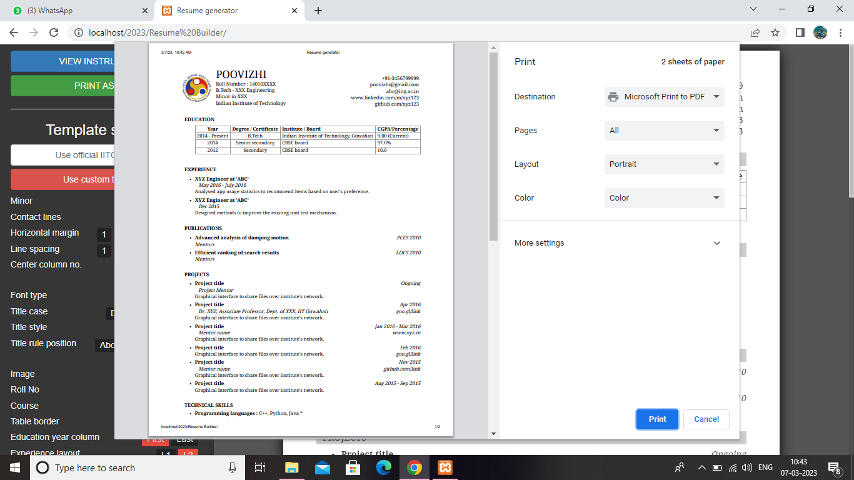

Slide 26
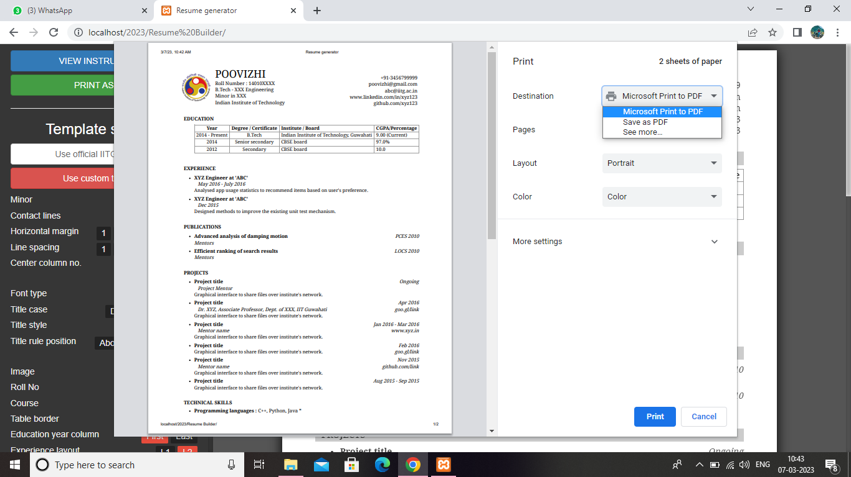

Slide 27
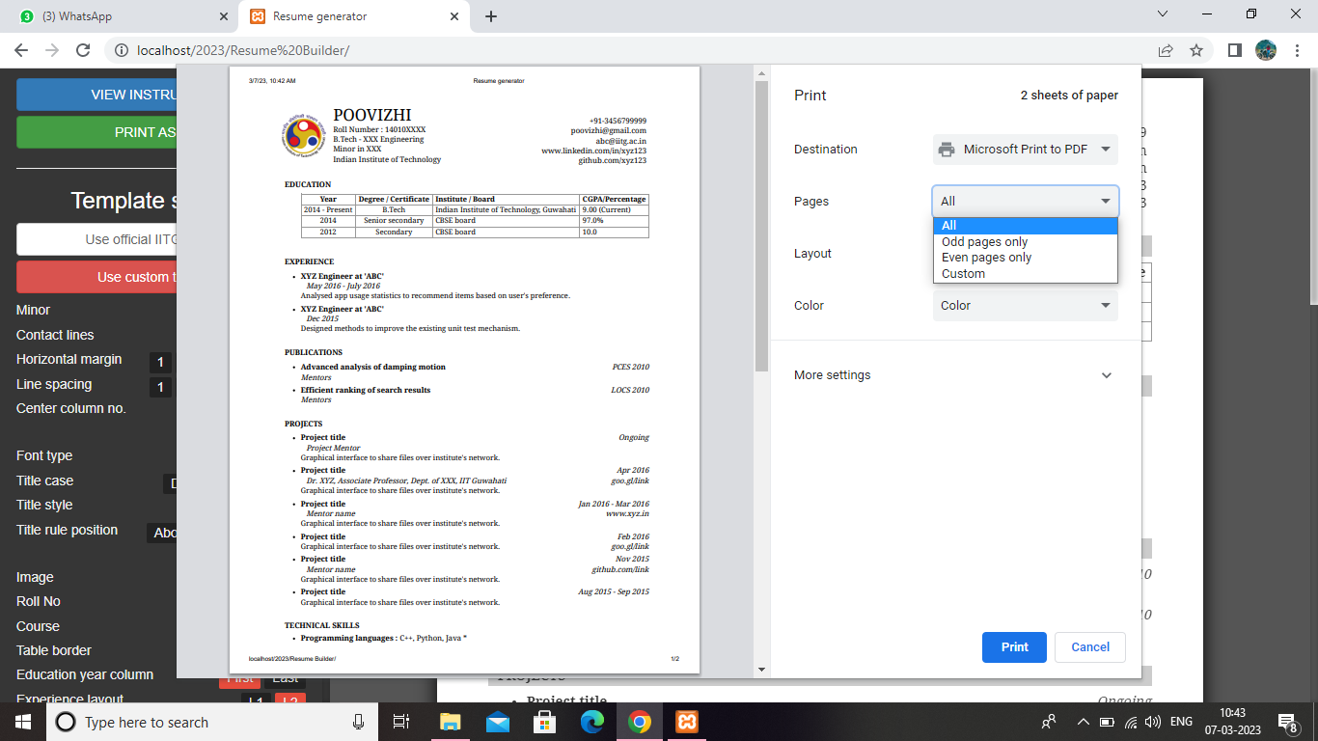

Slide 28
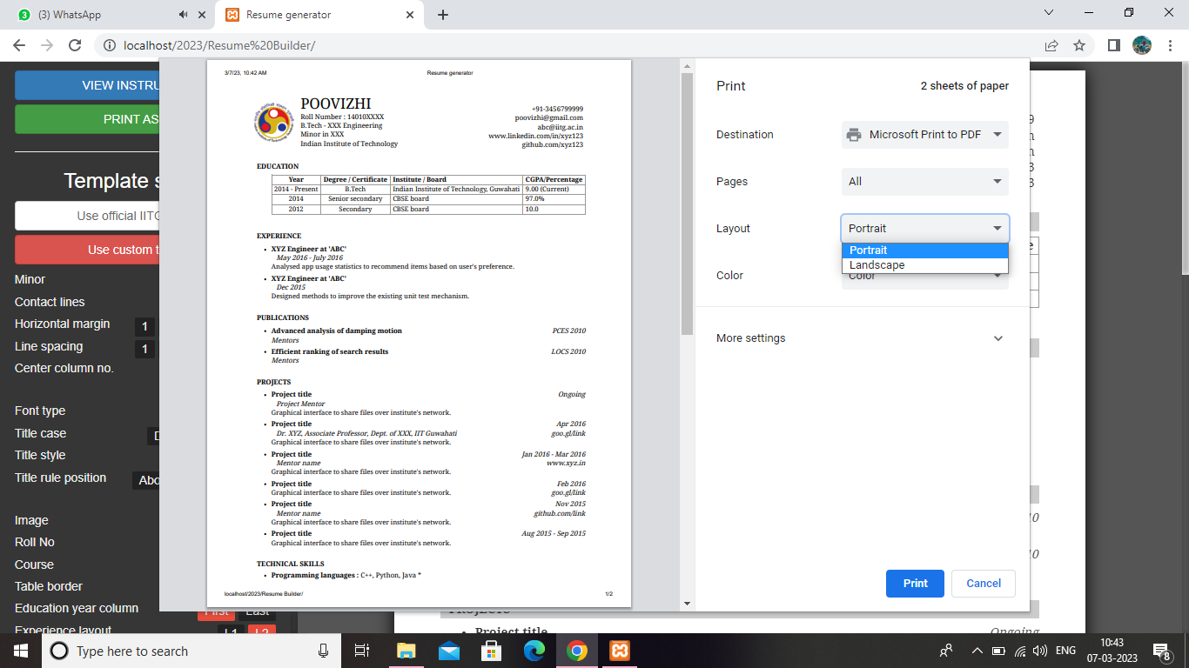

Slide 29
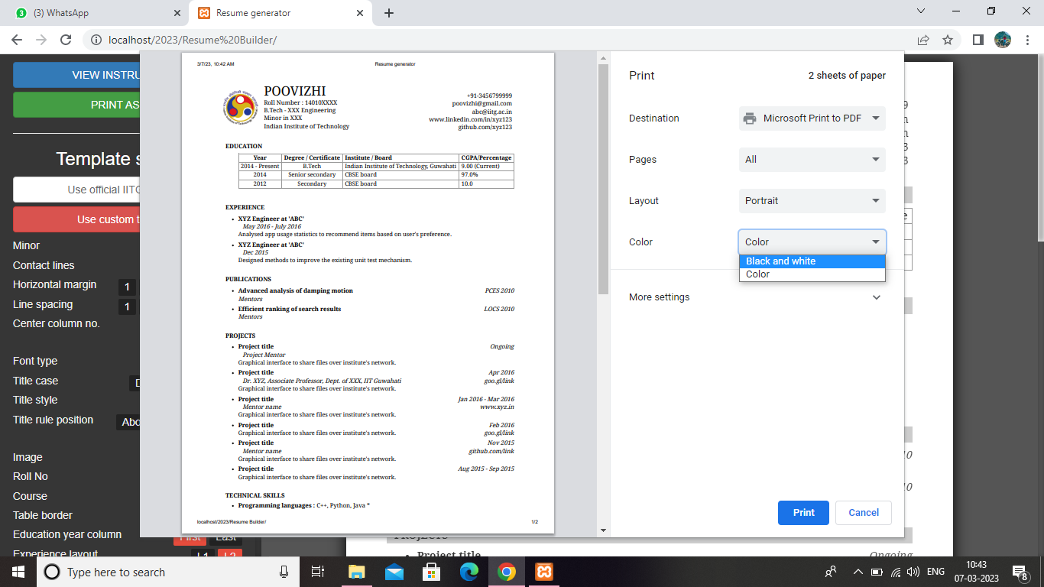

Slide 30
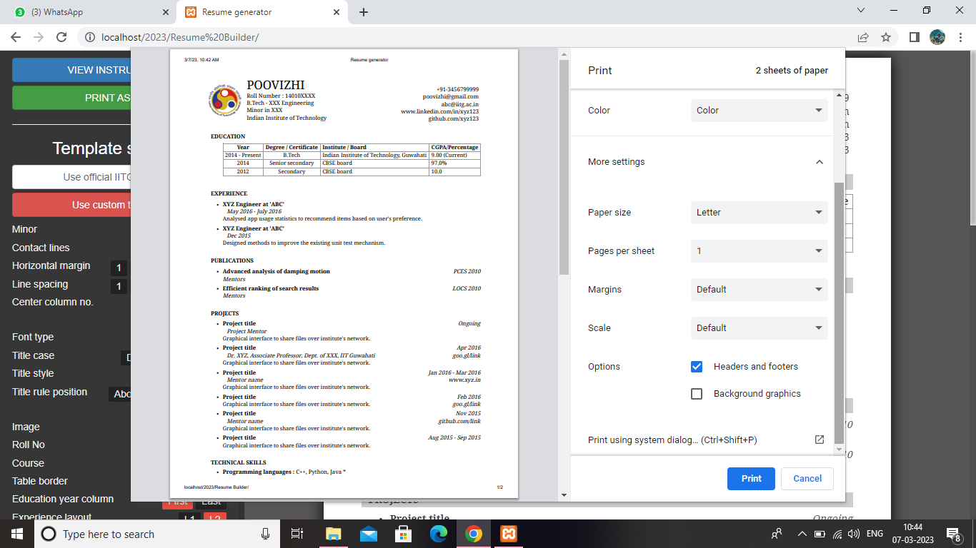

Slide 31
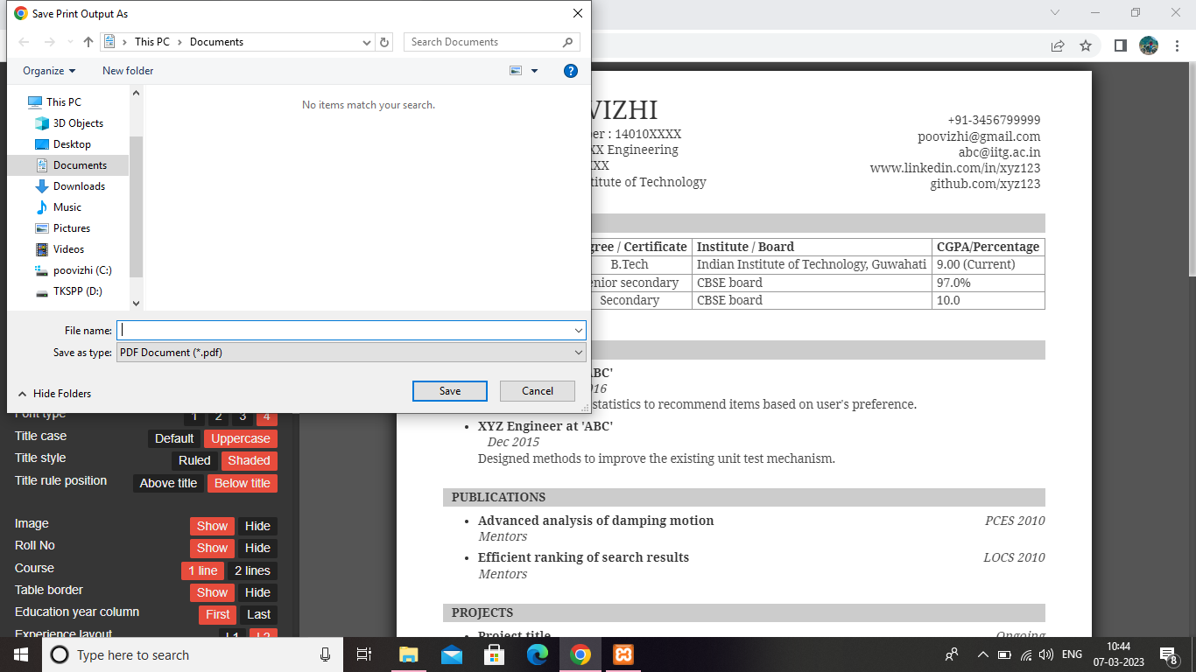

Slide 32
THANK YOU…

